Slide 1
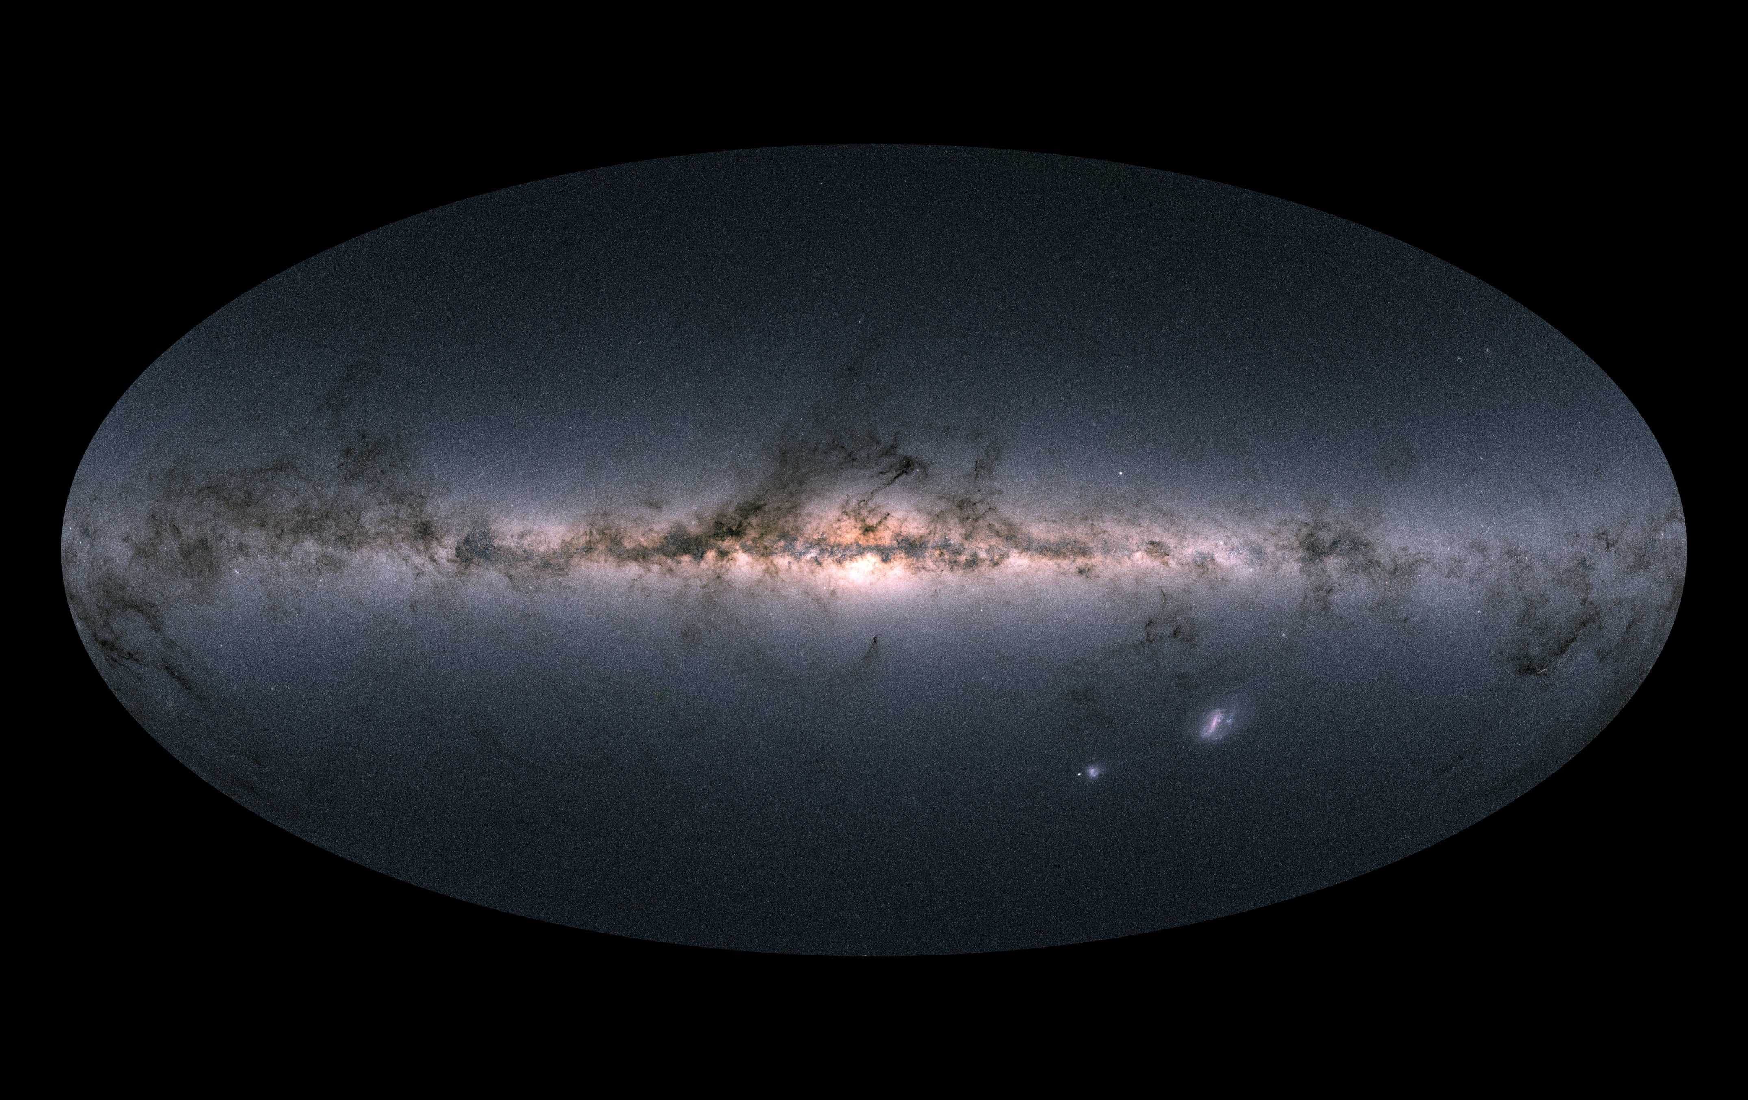
The Effects of the Galactic Center on the Ionization of the Magellanic Stream
Elaine Frazer
in collaboration with Andrew Fox, Joss Bland-Hawthorne (Univ. of Sydney), & Kat Barger (Texas Christian Univ.)
INS Tech Staff Meeting - May 8, 2019
(ESA/Gaia/DPAC)

Slide 2
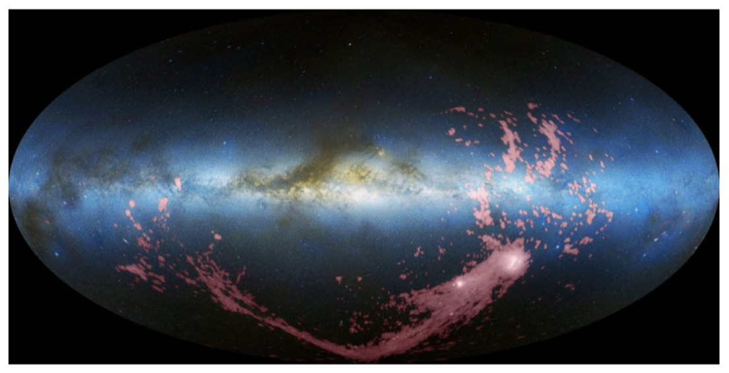
The Magellanic System around the Milky Way
Galactic Center
Leading Arm
LMC
SMC
Magellanic Stream
H I observations of the Magellanic System in Galactic coordinates, shown in pink (Nidever et al. 2010)

Slide 3
High Ions in the Stream and Leading Arm: 2 Models
The Seyfert flare model (Bland-Hawthorn et al. 2013)
the gas is photoionized by an energetic flash at the Galactic Center
the entire gas cloud is heated to the same temperature, and different ion species live in the same volume
spectra will show similar thermal broadening for low and high ion species
Si IV
QSO
Si II
Si II
Si IV
Absorber
Si IV
flux
Si II
velocity
Observed Spectra

Slide 4
High Ions in the Stream and Leading Arm: 2 Models
The two-phase model
the high ions arise in turbulent or conductive mixing layers between the cool Stream/LA and the hot Galactic corona, so the high and low ions will be separate
the high-ion absorption will be broader and/or offset in velocity from the low-ion absorption
Si IV
Si IV
QSO
Si II
Si II
T₁
T₂
T₂ > T₁
Si IV
Absorber
Si IV
flux
Si II
velocity
Observed Spectra

Slide 5
Data and Analysis
6 Stream and 6 LA sightlines with COS/FUV spectra
Fit Voigt profiles using VoigtFit (Krogager 2018) to
low ions(O I, C II, S II, Si II)
medium ions (Si III)
high ions (Si IV, C IV)
The VoigtFit module outputs the relative velocity, b-value (width of the component), and column density
With these values, we can look for
evidence of enhanced ionization in the Stream below the Galactic pole
differences between the distribution of absorption strengths in the Stream and LA
absorption from the Stream
absorption from Milky Way

Slide 6
Leading Arm Sightlines
4 w/ mis-aligned components

Slide 7
Leading Arm Sightlines
4 w/ mis-aligned components
2 w/ components seen in high ions, but not low ion

Slide 8
Leading Arm Sightlines
4 w/ mis-aligned components
2 w/ components seen in high ions, but not low ions
2 w/ components seen in low ions, but not high

Slide 9
Magellanic Stream Sightlines
1 w/ mis-aligned components

Slide 10
Magellanic Stream Sightlines
1 w/ mis-aligned components
1 w/ components seen in high ions, but not low ions

Slide 11
Magellanic Stream Sightlines
1 w/ mis-aligned components
1 w/ components seen in high ions, but not low ions
2 w/ components seen in low ions, but not high

Slide 12
Magellanic Stream Sightlines
1 w/ mis-aligned components
1 w/ components seen in high ions, but not low ions
2 w/ components seen in low ions, but not high
Fewer mis-aligned components in the Stream than in the LA:
points to two phase model for the LA and Seyfert flare model for the Stream

Slide 13
The LA shows differences between the high-ion and low-ion kinematics. The Stream does not.
Lends more evidence to the two phase model for the LA and the Seyfert flare model for the Stream

Slide 14
We find stronger high-ion absorption in the Stream than in the Leading Arm
The LA is much closer to the Milky Way disk where the density of the ambient gas is higher, so it is unexpected that the Stream would have stronger high-ion absorption. Could be due to the GC?

Slide 15
More evidence for slight high-ion enhancement in the Stream in the region below the Galactic Center
4
1
3
2
5
6
12
8
11
9
10
7

Slide 16
Continuing Work
We are working to add the full sample of 71 Magellanic sightlines from Fox et al. 2014+2018 to our plots
Currently writing up a Journal article
Thank you!

